Slide 1


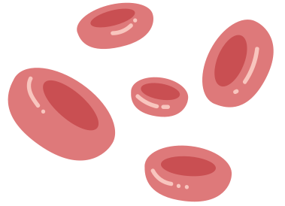
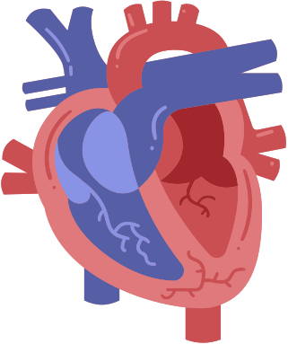


ENFERMEDADES CARDIOVASCULARES
Proyecto Machine Learnig

Slide 2



2
¿SE PUEDE PREDECIR UNA ENFERMEDAD CARDIOVASCULAR?
​Las enfermedades cardiovasculares (ECV) continúan siendo una de las principales causas de mortalidad a nivel mundial.
El objetivo de este proyecto es explorar el conjunto de datos relacionado con las enfermedades cardíacas mediante un análisis exploratorio de datos (EDA) y aplicar algoritmos de clasificación para realizar predicciones.

Slide 3



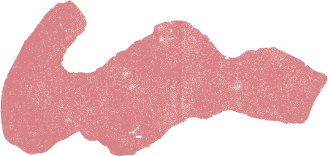
3
TODAY, YOU WILL...
Name and describe the main parts of the human circulatory system.
Describe the role of the heart, blood and blood vessels.

Slide 4


4
THE HUMAN CIRCULATORY SYSTEM
Function
Main Parts
To transport blood, oxygen and nutrients to the body
Has three main parts: the heart, blood vessels and blood

Slide 5


5
THE HEART
left atrium
right atrium
It works as a pump to move the blood around the body.
It has four chambers—two atria (upper chambers) and two ventricles (lower chambers).
right ventricle
left ventricle

Slide 6


6
THE HEART
Let’s examine how blood flows through the heart.
from upper body
1
The right atrium takes in blood carrying carbon dioxide.
to left lung
1
Blood is squeezed down into the right ventricle and taken to the lungs, where oxygen replaces carbon dioxide.
2
2

Slide 7
7
THE HEART
Let’s examine how blood flows through the heart.
Oxygen-carrying blood from the lungs enters the left atrium.
to body
3
3
from left lung
Blood is pumped into the left ventricle and starts its journey again throughout the body.
4
4

Slide 8
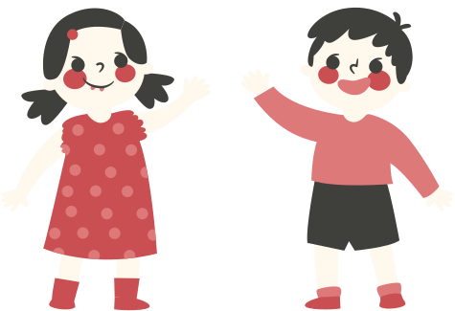

8
LESSON CHECK: THE HEART
Can you explain how blood flows through the heart with a partner, even without the diagram of the heart?
Try explaining the process to your peer without referring to your notes.

Slide 9
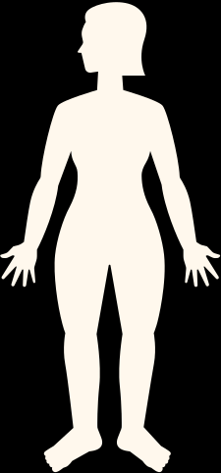
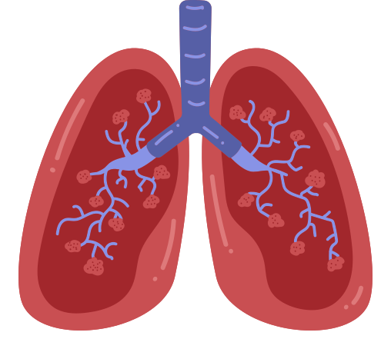
9
SAMPLE ANSWER
LESSON CHECK: THE HEART
Right Atrium
Left Atrium
body
lungs
Can you explain how blood flows through the heart with a partner, even without the diagram of the heart?
Right Ventricle
Left Ventricle
Shown is a sample diagram of how blood flows through the heart.
lungs
body

Slide 10


10
BLOOD
It is a special fluid primarily contained within the blood vessels.
It has four main components—red blood cells, white blood cells, platelets and plasma.

Slide 11

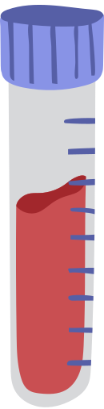


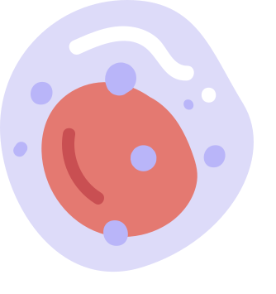
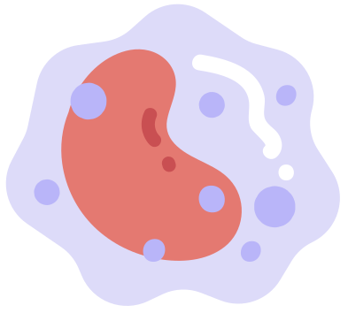
11
BLOOD
Our blood has four main components:
Red Blood Cells
Platelets
carry oxygen, nutrients and wastes
gather at the site of injury and help the clotting process
White Blood Cells
Plasma
fight diseases and protect the body from infection
straw-coloured liquid where the other components float in

Slide 12
12
BLOOD
plasma
When someone has a blood test, a small amount of blood is taken and kept in a tube for testing.
white blood cells and platelets
red blood cells
To closely examine it, blood undergoes component separation. One common method involves spinning it at very high speeds in a centrifuge.
Blood is divided into its components, with the heaviest parts at the bottom.

Slide 13
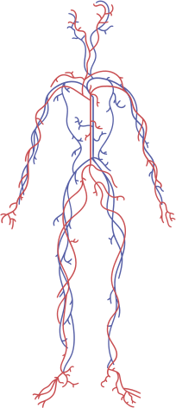
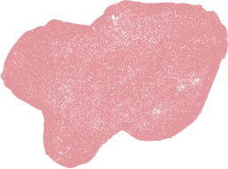
13
BLOOD VESSELS
These are tubes or channels that carry blood throughout our body.
There are three types of blood vessels—veins, arteries and capillaries. Each one differs in size and structure.

Slide 14

14
BLOOD VESSELS
Let’s take a closer look at the three types of blood vessels:
It has the thickest wall of all three, allowing it to withstand the high pressure created by the heart.
Artery
It has the thinnest wall to allow substances such as oxygen and sugars to pass through its wall—into or out of the blood.
Capillary
It is less muscular and stretchy than an artery, so blood moves through it with low pressure. It also has a special valve that helps blood go only one way.
Vein

Slide 15

15
BLOOD VESSELS
Each type of blood vessel has a unique role in the circulatory system.
Artery
Capillary
Vein
Carries blood away from the heart
Assists in the exchange of substances between the blood and tissues
Carries blood back towards the heart
TIP
Remember ‘A’ for ‘artery’ and ‘away’ from the heart!

Slide 16

16
LESSON CHECK: SICKLE CELL DISEASE
Sickle cell disease (SCD) is an inherited blood disorder. People with SCD have red blood cells that become hard and sticky, forming a C-shaped blood cell instead of the healthy disc-shaped one.
Considering what you’ve learnt about blood and blood vessels, how does this shape affect blood flow in the circulatory system?

Slide 17
17
SAMPLE ANSWER
LESSON CHECK: SICKLE CELL DISEASE
Considering what you’ve learnt about blood and blood vessels, how does this shape affect blood flow in the circulatory system?
The irregular shape of the sickle-shaped blood cell makes it easy to clog and block the blood flow.
This can cause pain and other serious infections.

Slide 18

18
A RECAP
The circulatory system delivers oxygen and nutrients to the body, while also removing wastes.
Heart
Blood
Blood Vessels
Muscular organ that has four chambers
Pumps blood around the body
Has four components: plasma, red blood cell, white blood cell and platelets
Carries oxygen, nutrients and wastes
Has three types: arteries, veins and capillaries
Serve as channels for the blood

Slide 19


19
A DAY IN THE LIFE OF A RED BLOOD CELL
Write a story as though you are a red blood cell.
Some guide questions you can use are:
What do you look like?
What is your job?
Where are you found?
Where do you travel from and to?

Slide 20
Try this background for online class.
*Please delete this section before downloading.

Slide 21
PRESS THESE KEYS while on Present mode!
B
C
for blur
for confetti
D
M
for mic drop
for a drumroll
O
O
for bubbles
for quiet
U
0-9
Any number from 0-9 for a timer
for unveil

